Slide 1
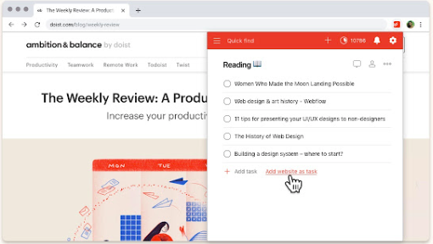
Docket
(Check list Extension)
By :
Siddharth Dahiya
Yash Dahiya
To- Do list

Slide 2
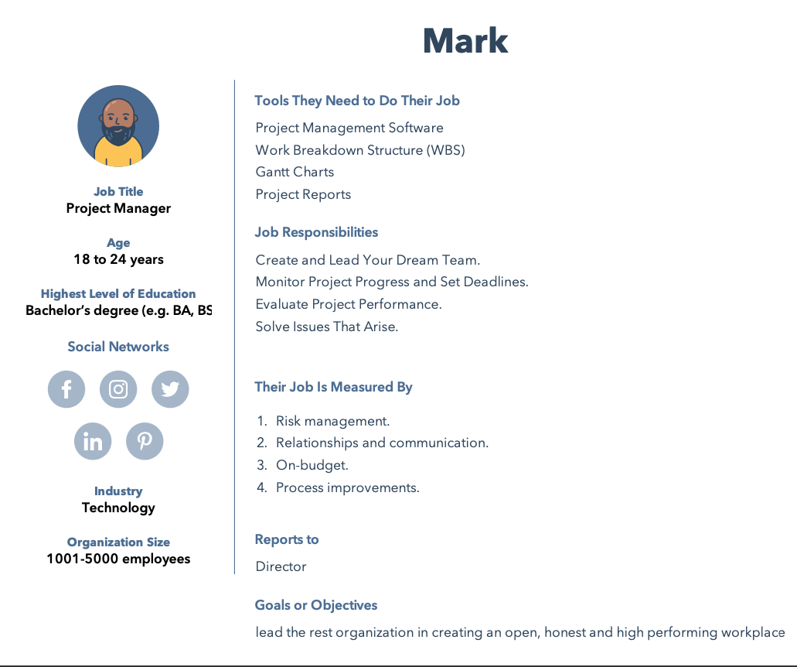
User Persona
Ideal user persona

Slide 3
How will Docket help mark?
Motivates the team
By finishing items on a to-do list, team members often feel accomplished and motivated to continue working on other tasks to complete the project successfully.
Improves Productivity
Having a to-do list can help team members see the various tasks they can complete to move a project forward, which can improve productivity among a team.
Delegating Tasks
Writing a to-do list can help project managers understand all the tasks of a project so they can delegate these assignments effectively.
Analysing work
By maintaining a to-do list, project managers can review and analyze the work their team has done on a project, which can help them identify best practices for future projects.

Slide 4
Reason for making Docket?
Personal Experiences with people who spend a lot of time working on a desktop or laptop.

Slide 5
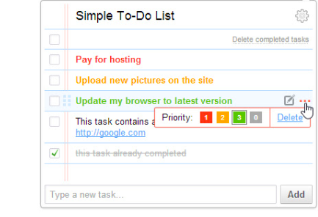
What is Docket?
While browsing use this extension to organise one’s work and life. It allows user to capture and order task as they come to mind. Also, it reminds deadlines and due date with respective lists.
A list of errands and other tasks often written as memory aid, that one needs or intend to accomplish.
Caption

Slide 6
Conclusion for Docket
It offers a way to increase productivity.
It helps one from forgetting things.
It helps prioritise tasks and manage them efficiently.
It helps with using time wisely and improve time management as well as the workflow

Slide 7
Questions?
For more information refer to the below:
https://github.com/yashdahiya0/CS4540-Mozilla-Project-Group-7

